Slide 1



Forms Recognizer Workshop using Business Process Accelerator and Form Recognizer Studio

Slide 2
Meet the team
Brandon Cowen
Harmke Alkemade
Mark Remmey
Chu Lahlou
Mahi Sundararajan
James Hoff
Safdar Zaman
Vijay Patil
Nandini Ganapathy
Gurkamal Deep Singh Rakhra
Kaushik Bardhan
Notes:
There’s lot lingo, this will help you get level setted with our services we’ll be referencing when talking about bpa next
As you move down from an excel user to someone writing custom models

Slide 3
Agenda
Azure Cognitive Services
BPA Accelerator Overview
Demo of the Accelerator
Form Recognizer Overview
Hands-on Lab 1
Hands-on Lab 2

Slide 4

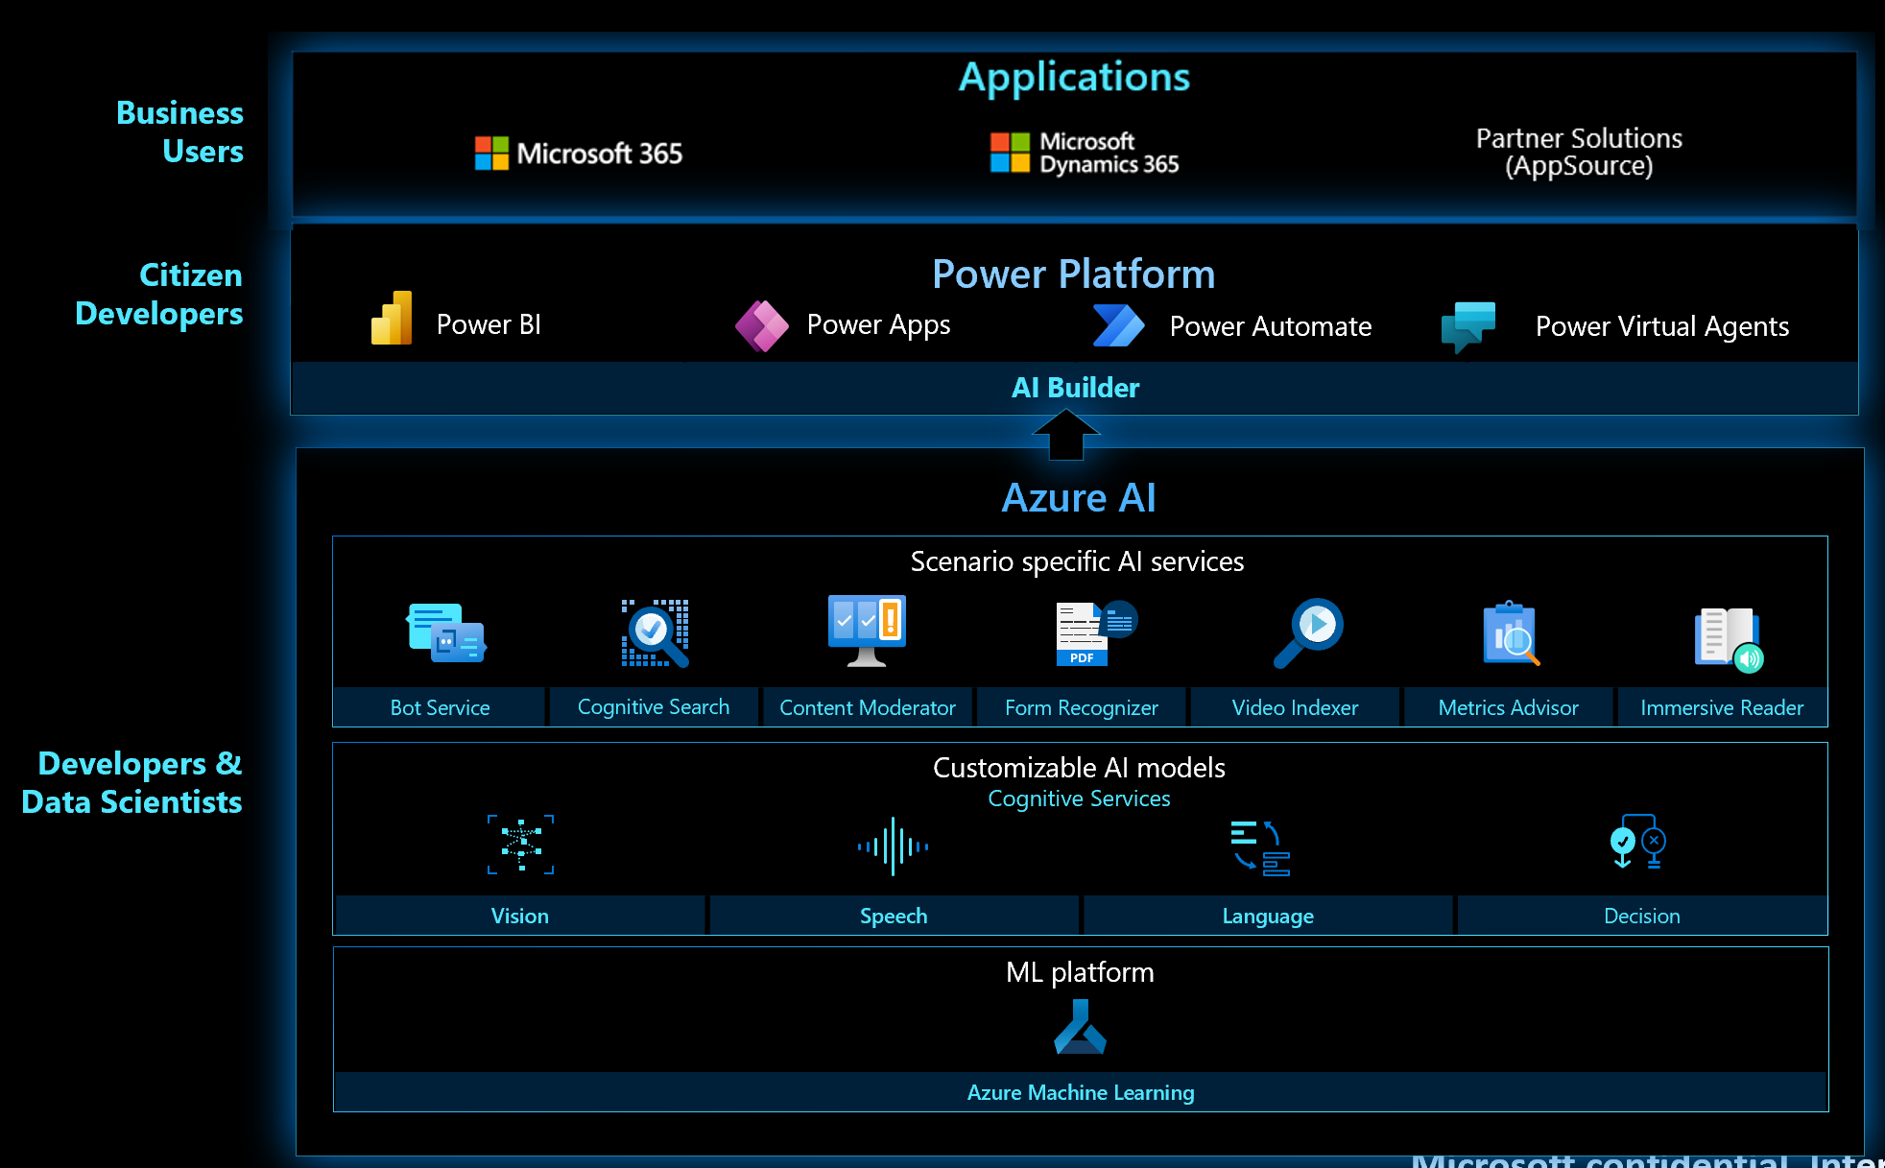
Microsoft Portfolio of AI
<- Security, Compliance & Identity ->
Notes:
There’s lot lingo, this will help you get level setted with our services we’ll be referencing when talking about bpa next
As you move down from an excel user to someone writing custom models

Slide 5




AI Services for Audio & Document Intelligence
Speech
Computer Vision
Form Recognizer
Language
Language
Document Layout & Structure Extraction
Entity identification
Transcription
Optical character recognition
Text classification*
Key value pairing
Custom / Domain-Specific Speech
Image describe
Custom models
Sentiment analysis
Text summarization
Translation
Notes:
[30s]
Here, you can see some of the common use cases for several major Cognitive Services,
Some of which we’ll show in the demo,
And as the Services are aligned by domains, it’s relatively intuitive the use cases that they cover, for example our speech service essentially covers use cases involving audio files:
Transcription (across over a 100 languages) via a multi-lingual transformer
And Translation
With customizable voices and models
And our Computer Vision and Language Services
And Form Recognizer, which is focuses on image-based document extraction techniques

Slide 6
“Again and again, we hunt for that document we urgently need and it is nowhere to be found. We have more data than ever before, but we struggle to navigate to the right data the moment we need it” –Everyone (at some point)
Notes:
[30s]
“Pause”
So, before we jump into the demos, let’s talk about “why” we might need this, and then, “what” we’re going to use it for, and “how” we’re going to do it.
Who can relate to this quote?
<<read the quote>>
There’s many challenges to deploying state-of-the-art deep learning models, from multiple domains, with real-world, messy data, at-scale

Slide 7

Challenges
Organizations amass many inputs:
which require AI expertise across multiple domains (NLP, CV, speech, ..)
Accelerator brings together multiple Cognitive Services together in a single studio/tool
Manual data entry and extraction could be costly and erroneous
Documents are everywhere, and are, unfortunately, still a major communication tool between organizations
Let the data scientists focus on AI. AI pipelines typically require developers and data scientists to develop and implement the solution, as well as long term management
Notes:
[30s]
There’s many challenges to deploying state-of-the-art deep learning models, from multiple domains, with real-world, messy data, at-scale
Many inputs:
PDF’s
machine documents
Images
emails, audio (calls) etc..
So how does BPA help?

Slide 8



How is the Business Process Accelerator (BPA) used?
Deploying multiple Azure Cognitive Services can help ingest, extract and enrich data
Ingest
Deploy Template Repo
Studio (React Web APP)
Ingest
Extract
Enrich
Deploy repo
Utilize React Website automatically deployed by BPA repo.
Read API OCR engine or Form Recognizer for digitizing printed or handwritten documents
Use pre-trained or custom AI models for entity and key pair extraction with Form Recognizer Service
Use prebuilt AI services like Text Analytics or custom text for text models to enrich the data and make it relevant to your business needs
Quickly leverage Cognitive Search across document enrichments
Notes:
[90s]
Ok, what is and how does this accelerator help us?
The BPA basically provides a Studio – a UI – and all of the backend, managed Services, orchestrated by Azure Functions, for a user to quickly select and deploy multi-domain pipelines.
As you’ll see, With the demos, through the BPA Studio, you can start from an audio file, or a PDF, or a text file, and slowly start to build, transformation by transformation, a pipeline
Maybe starts from audio in Spanish, translated to English, transcribed to text, further summarized abstractively or extractively, and translated to mandarin
A pretty straightforward use case, but you’re already using one powerful base model for transcription, another for translation, and yet another SOTA model for summarization
And with this pipeline, we’ve only touched 2 Cognitive Services
There’s much more information in our Repo, but let’s jump into our technical demos
And I’ll hand over to my colleague, James Hoff, from here
-------------------
template for a user to deploy a managed set of these Services in their own Resource Group,
The BPA provides a no code Studio for users to quickly build complex, multi-stage AI pipelines across multiple Azure AI and ML Services. You can select, and stack, not just Cognitive Services, but custom models from Azure Machine Learning, and even open source Hugging Face, all still within a single, fully integrated pipeline. Your Azure credentials management, and general integration between services, is automated by BPA. And once deployed, a web app providing that pipeline builder UI or studio is created. And, from there, the end user can drag-n-drop documents, audio files, etc.. Triggering the newly created pipelines.
And, optionally, the end-user can easily create a Cognitive Search Index, across all of the enriched metadata or content extracted from the files.

Slide 9
Common Use Cases: Contact Center – NER Classification, Speech to Text, Sentiment Analysis, Translation Document Search – Cognitive Search, NER Custom Model, OCR, Translation Form Recognition – Parse fields from common forms automatically Personal Information Redaction (PII) - OCR, PII Language Service
Notes:
https://fott-2-1.azurewebsites.net/

Slide 10
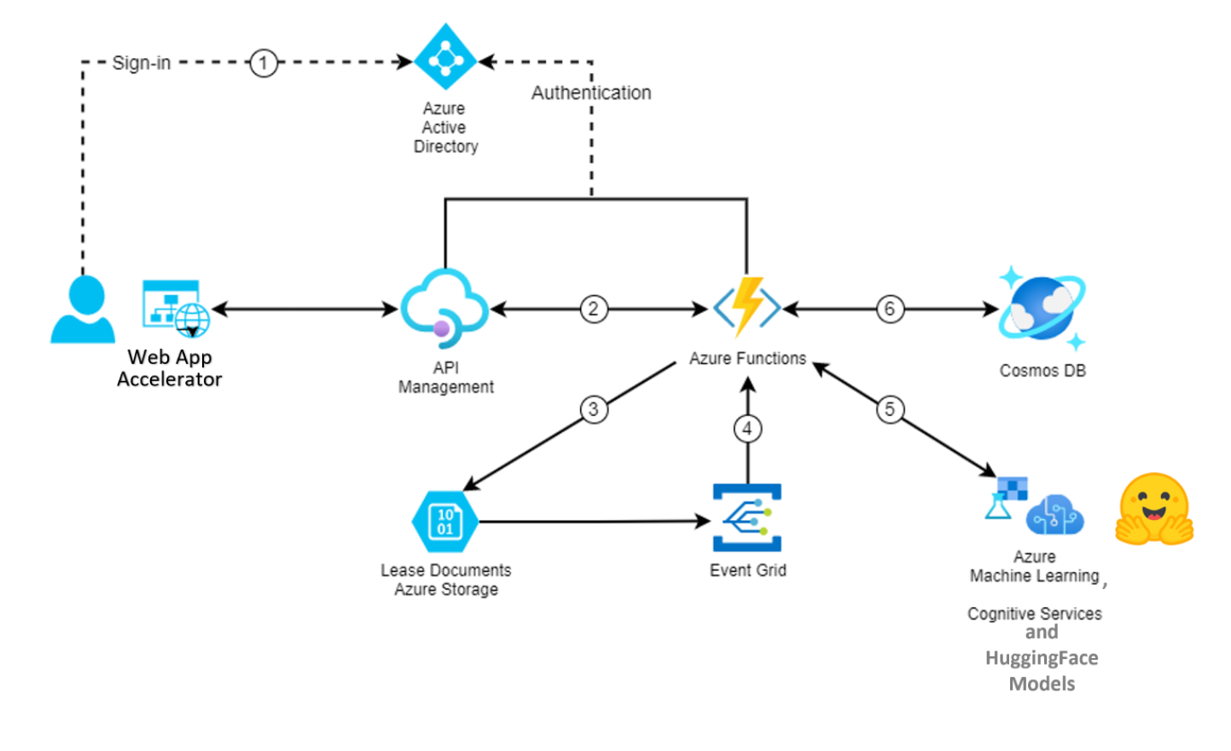
Example Use Case: Lease Processing

Slide 11
Demo
BPA Accelerator demo Generic use case - NER

Slide 12
Demo
BPA Accelerator demo with Form Recognizer

Slide 13

Azure Form Recognizer Overview
Cloud-based service that uses machine-learning models to extract and analyze form fields, text, and tables from your documents.
It easily identifies, extracts, and analyzes the following document data:
Table structure and content
Form elements and field values
Typed and handwritten alphanumeric text
Relationships between elements
Key/value pairs
Element location with bounding box coordinates

Slide 14

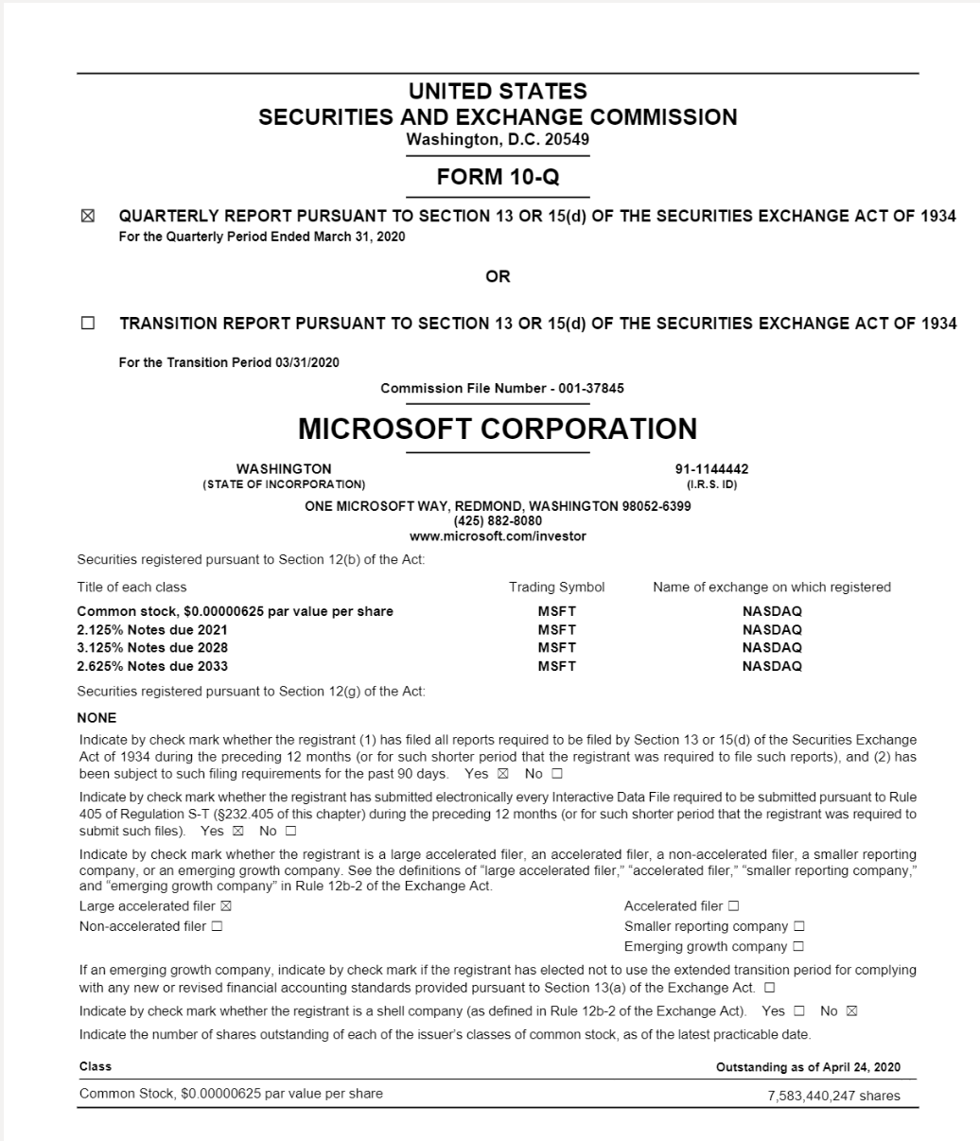
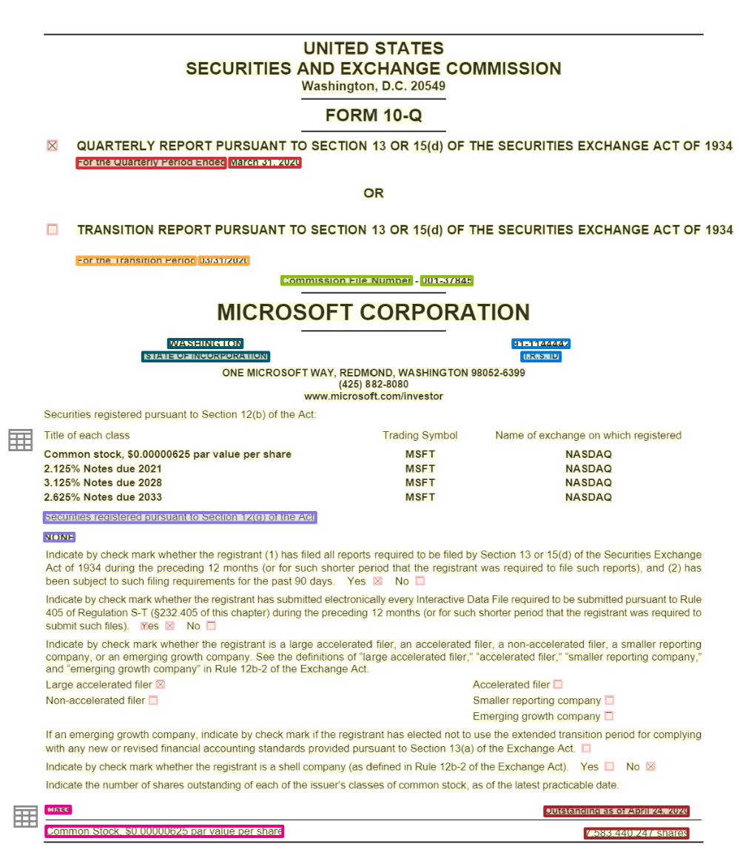
Form Recognizer
Extracts information from documents and turns unstructured content into business ready structured content
Text
Structure
Tables
Key Value Pairs
Entities
READ
LAYOUT
DOCUMENT
PREBUILT
CUSTOM
Automatic text extraction from documents (PDFs, Images, Word, HTML) for printed and handwritten documents for 164 languages
Automatic document structure extraction – lines, paragraphs, tables, selection marks, barcodes
Automatic document understanding from unstructured and structured documents extract Key value pairs and entities
Automatic understanding of Invoices, receipts, business cards, W2, IDs, Health Insurance Cards, Vaccine Cards.* and lots more coming soon
Train a custom model tailored to your documents. Get started with 5 documents only

Slide 15








How it works
Ingest Documents
Form Recognizer Document Understanding
Consume
Layout
Prebuilt
Custom
images
Pre-Processing
de-noising (improve resolution), background noise, watermarks removal
General Documents
Invoices
Templates
Train a model for structured documents
Text Extraction
Character, word, line, blocks read order bounding boxes
handwritten \ printed
ID
PDF
Insurance Cards
Segment analysis
Paragraphs, sections, headers, table of contents etc.
W2
Neural Model
Train a model for unstructured document
Word
Vaccine Cards
Structure Recognition
Tables, selection Marks
Barcodes, images
Receipts
Health Insurance Cards
Only a handful of documents needed to get started and train a model
HTML
And more

Slide 16

Form Recognizer Studio Layout, Prebuilt and General Document models

Slide 17
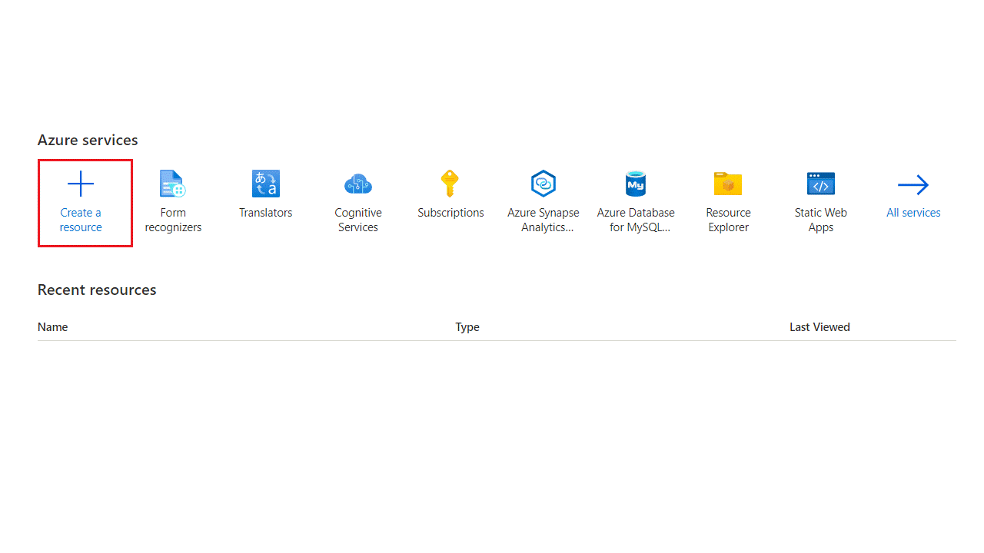
Creating a Form Recognizer Resource

Slide 18
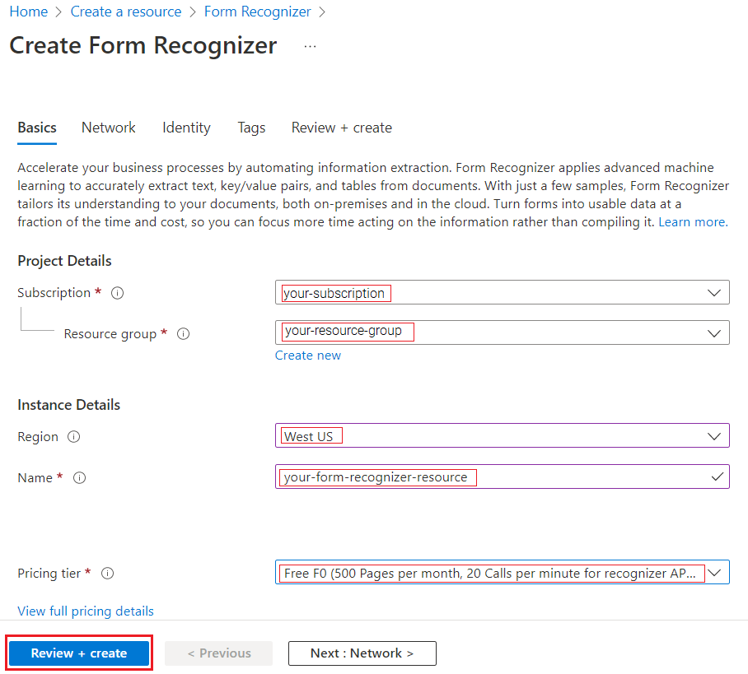
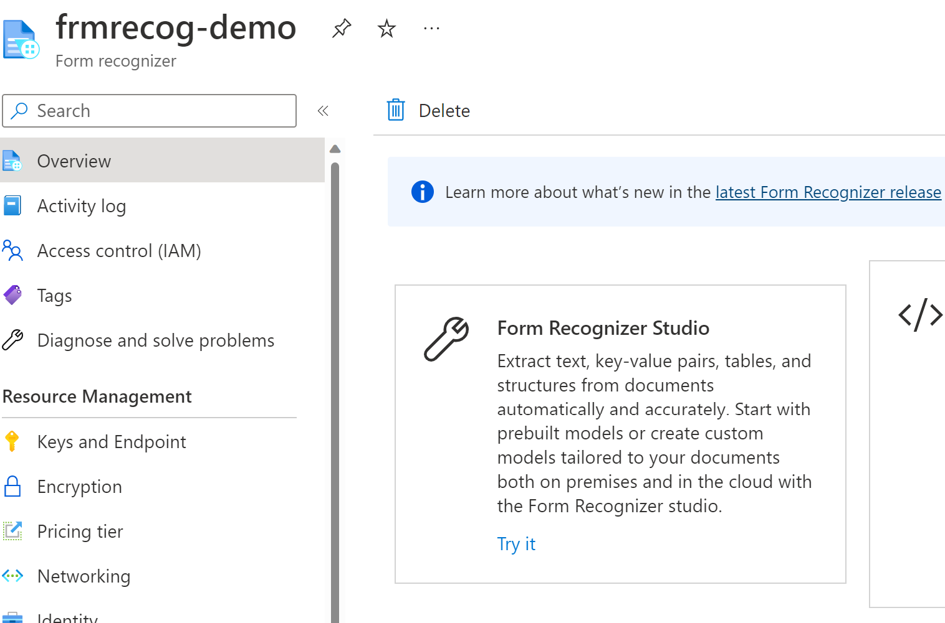
Create Form Recognizer

Slide 19
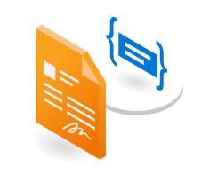
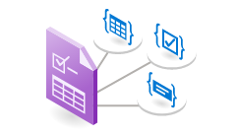
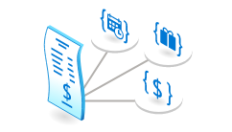
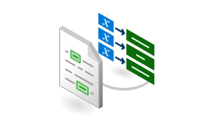


Form Recognizer capabilities
Read
Layout
Prebuilt[s]
General key
value pairs
Template
models
Neural models
Prebuilt models for ID, receipts, invoices, W-2 and more
Pretrained mode to extract key value pairs and entities from documents
Train a model in minutes to extract specific key value pairs. Documents with consistent structure
Train a model to extract key value pairs from unstructured documents
Extract text from documents
Extract text & structure from documents

Slide 20
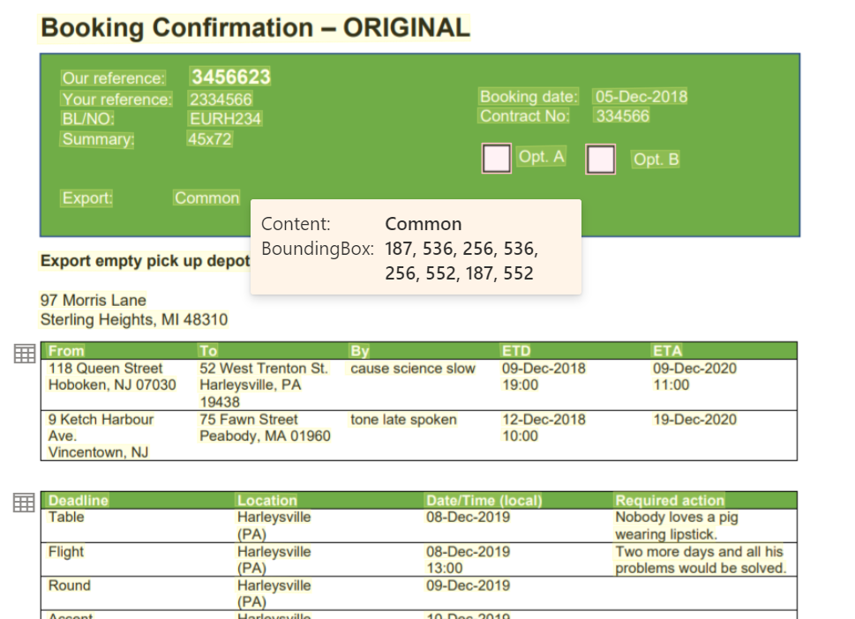
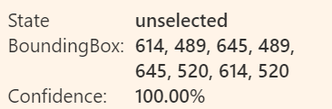
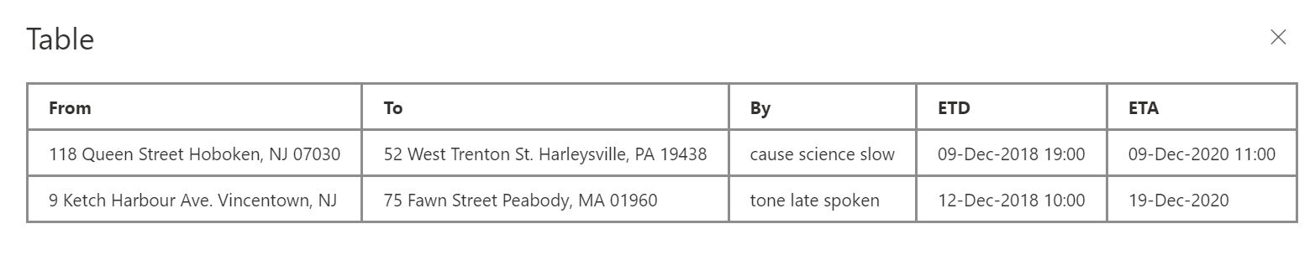
Layout
Extract text and their locations
Extract structural elements like tables and selection marks
Extracts print and handwritten text for the full list of supported languages
More structural elements like titles, headers, footers, paragraphs, captions coming soon.

Slide 21
164 languages
English
French
Italian
German
Spanish
Portuguese
Dutch
Chinese Simplified
Chinese Traditional
Japanese
Korean
Czech
Hungarian
Polish
Swedish
Turkish
Danish
Norwegian
Cebuano
Fijian
Swahili (Latin)
Uzbek (Latin)
Zulu
Afrikaans
Albanian
Indonesian
Malay (Latin script)
Filipino
Catalan
Galician
Basque
Haitian Creole
Irish
Javanese
Scottish Gaelic
Scots
Romansh
Luxembourgish
Occitan
Breton
Asturian
Neapolitan
Western Frisian
Corsican
Friulian
Manx
Kara-Kalpak
Gilbertese
Bislama
Kachin (Latin script)
Khasi
Hani
Greenlandic
Tetum
Zhuang
Volapük
Interlingua
Kabuverdianu
Cornish
Hmong Daw (Latin)
Inuktitut (Latin)
K’iche’
Yucatec Maya
Estonian
Finnish
Slovenian
Kashubian
Kurdish (Latin)
Tatar (Latin)
Crimean Tatar (Latin)
Chamorro
Upper Sorbian
Walser
Azerbaijani (Latin Script) Belarusian (Latin Script) Bosnian (Latin Script) Croatian Faroese Gagauz (Latin script)
Hawaiian Icelandic Inari Sami
Kazakh (Latin Script)
Kosraean Lakota Latin Lithuanian Lower Sorbian Lule Sami Maltese Maori
Montenegrin (Latin Script) Niuean Northern Sami (Latin script) Ripuarian Romanian Samoan (Latin script) Serbian (Latin Script) Russian Bulgarian Ossetic Kazakh (Cyrillic Script) Kyrgyz (Cyrillic Script) Mongolian (Cyrillic Script) Montenegrin (Cyrillic Script) Tajik Uzbek (Cyrillic Script) Belarusian (Cyrillic Script) Karachay-Balkar
Koryak Buryat (Cyrillic Script) Tuvan Kara-Kalpak (Cyrillic Script)
Kumyk (Cyrillic Script)
Nogay Erzya (Cyrillic Script)
Skolt Sami Slovak
Southern Sami Tongan Turkmen (Latin script) Welsh
Hindi
Marathi
Nepali
Haryanvi
Sanskrit
Bhojpuri-Hindi (Devanagari Script)
Bundeli
Angika (Devanagari Script)
Awadhi-Hindi (Devanagari Script)
Bagheli
Mahasu Pahari (Devanagari Script)
Brajbha
Bodo (Devanagari Script)
Dhimal (Devanagari Script)
Dogri (Devanagari Script)
Gondi (Devanagari Script)
Gurung (Devanagari Script)
Halbi (Devanagari Script)
Chhattisgarhi (Devanagari Script)
Ho(Devanagiri Script)
Jaunsari (Devanagari Script)
Korku
Khaling
Malto(Devanagari Script)
Kurukh (Devanagari Script)
Chamling
Santali(Devanagari Script)
Sadri (Devanagari Script)
Sirmauri (Devanagari Script)
Thangmi
Kangri (Devanagari Script)
Sherpa (Devanagari Script)
Arabic
Kurdish (ku)
Panjabi (pa)
Persian (fa)
Dari (prs)
Pushto (ps)
Somali (so)
Uyghur (ug)
Urdu(ur)
Uzbek (uz)

Slide 22
Train a custom model Template and Neural models

Slide 23
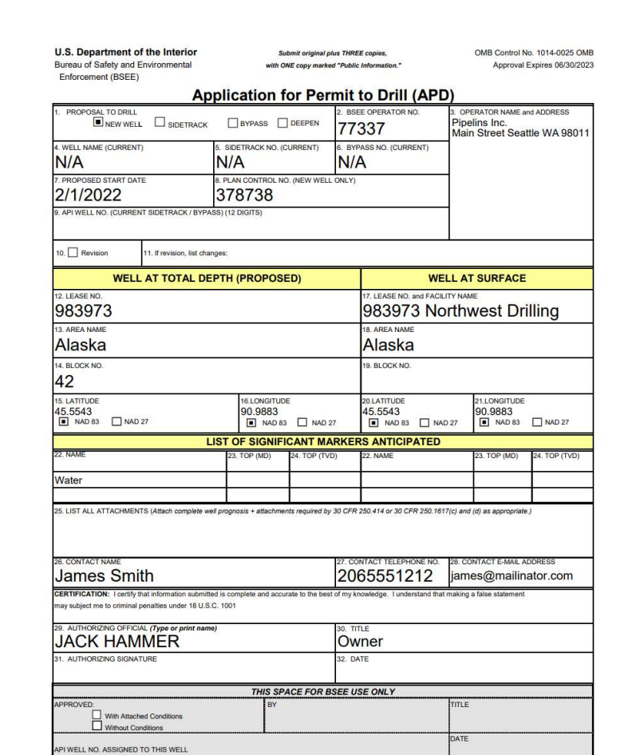
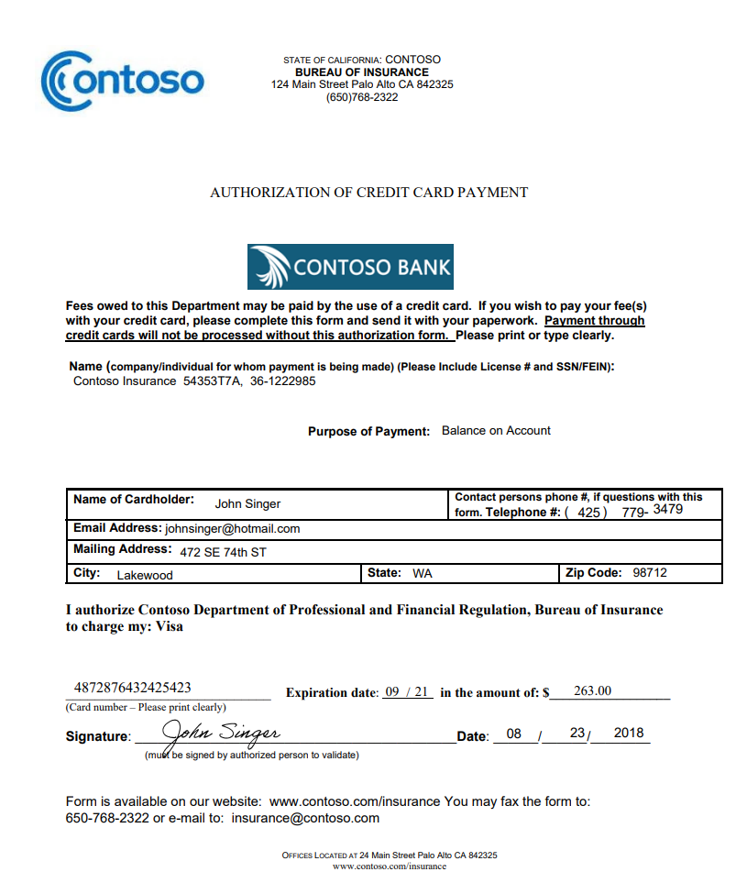
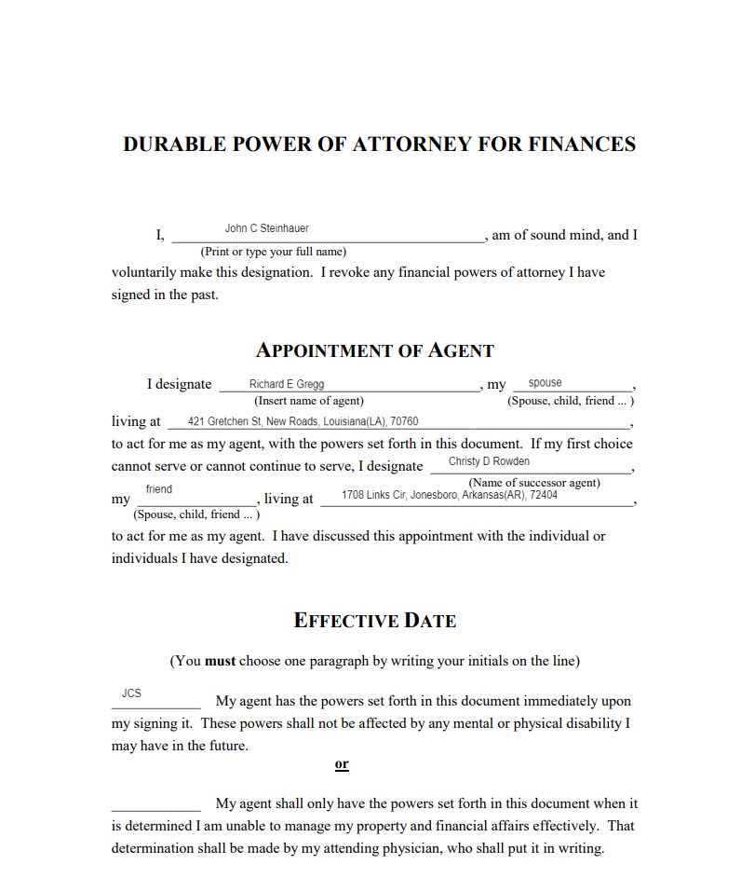
Forms or Documents
Structured
Semi-Structured
Unstructured
Template
Neural

Slide 24
Train a custom model
Prepare
5 samples per variation
Configure storage account
Label
Label fields and tables and signatures
Plan for variability
Train
Train a model in minutes
Analyze
Test model inference
At scale
Validate confidence scores

Slide 25






Choosing the right model
Template (custom form)
Neural (custom document)
Structure
Template/Form/Structure based extraction
Structured, semi structured and unstructured
Training Time
1- 5 min
30 min – 1 hour
Key value pairs, Tables, Selection Marks, Signatures, Regions
Key value pairs, Selection Marks
Features
Requires a model per variation
Single model for all variations
Variations
Multiple (see supported languages)
English only
Languages
Generated during training
Requires a validation dataset to be computed
Accuracy

Slide 26
Composed Custom Models
Composed models.
Collection of custom models and assigning them to a single model built from your form types.
With the model compose operation, you can assign up to 200 trained custom models to a single composed model.
For custom template models, the composed model can be created using variations of a custom template or different form types.
For Custom neural models, the best practice is to add all the different variations of a single document type into a single training dataset and train on custom neural model.

Slide 27
Demo
Form Recognizer resource Form Recognizer Studio

Slide 28
Hands-on Lab 1
Use the Form Recognizer prebuilt Invoice model
Develop pipeline on BPA accelerator using the prebuilt model
Visualize data in the search app

Slide 29
Hands-on Lab 2
Use custom model using Form Recognizer studio
Develop pipeline on BPA accelerator using the custom model
Visualize data in the search app

